Slide 1

Realtime Mediation
Pre-paid Billing

Slide 2
Example Scenario
The classic business case for this is pre-paid services where a customer has a balance and can only use a service as long as the balance remains positive. Every attempt to use the service has to check if there is enough balance.
Customer subscribes to a pre-paid plan.
Customer is required to maintain an advance balance.
Customer must have a minimum balance to make a call/purchase.
Validate the purchase against the pre-paid balance.

Slide 3


Example Scenario
Telco Company
Telephony System
Customer Account
Customer
Customer Dialing
Checking jBilling to see if the customer is allowed to the make call
Has the customer reached his credit limit?
Is the account overdue? Or Cancelled?
Does the plan allow the call?
Customer starts the call
Customer ends the call
How long did the call last?
jBilling updates customer’s account

Slide 4
Dynamic Balance
Pre-Paid
e.g. A Payement for $100 increments the pre-paid balance by $100. Customer is prevented from making a purchase above $100.
Types
Credit Limit
e.g. $100 of Credit Limit set on a Customer’s account means a customer is not allowed to spend above and beyond $100 without making a payment first.

Slide 5
Dynamic Balance
Pre-Paid
Credit Limit
Represents how much money someone has paid in advance to use a service.
Increases with every payment
Decreases with every order
Should not be negative
A validation fails if the purchase is grater than the dynamic balance
Represents how much money someone can “borrow” to use a service.
Increases with every order
Decreases with every payment
Should not be greater than the value of the ‘Credit Limit’ attribute
A validation fails if the purchase plus the dynamic balance is greater than the credit limit

Slide 6
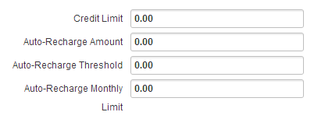
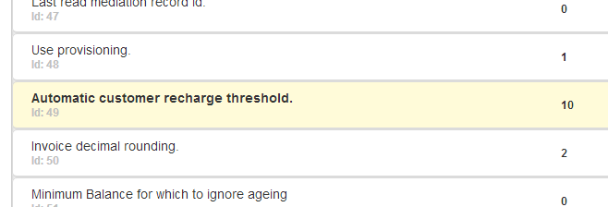
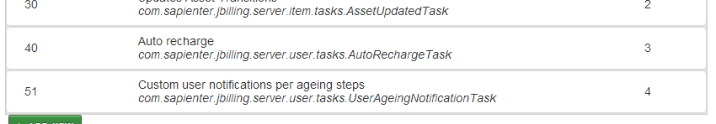
Configuration
Manual Payments
Automatic Recharge
Telco

Slide 7
Validate Purchase
Runs the mediation process for a single event, but it does not update the customer account. Instead, it checks if the customer has enough balance to purchase the charges that the event represents.
IValidatePurchaseTask
UserBalanceValidatePurchaseTask.java
RulesValidatePurchaseTask.java
ExampleValidatePurchaseTask.java

Slide 8
Validate Purchase
API Calls
Method | Description
public ValidatePurchaseWS validatePurchase(Integer userId, Integer itemId, String fields) {…} | It validates a purchase of a single item.
public ValidatePurchaseWS validateMultiPurchase(Integer userId, Integer[] itemIds, String[] fields) {…} | Same as the previous one but with multiple items.
public OrderWS rateOrder(OrderWS order, OrderChangeWS[] orderChanges) throws SessionInternalError {…} | Evaluates an order with pricing and item plugins without creating the order. Your application can show the order to the customer to approved it, and then create it.
public OrderWS[] rateOrders(OrderWS orders[], OrderChangeWS[] orderChanges) throws SessionInternalError {…} | Same as the previous one but with multiple orders.
public OrderWS getCurrentOrder(Integer userId, Date date) {…} | Returns the order that the mediation process is using to collect usage for a billing period.
public OrderWS updateCurrentOrder(Integer userId, OrderLineWS[] lines, String pricing, Date date, String eventDescription) {…} | Runs the mediation process for a single event, passed as an argument

Slide 9
Diameter
It’s a protocol used in the Telecom Industry often called AAA (Authentication, Authorization and Accounting).
Much better than old protocols like RADIUS.
We only implemented a part of Diameter to manage reservations of units based on the dynamic balance of the user.

Slide 10
Diameter
No User Found
No Item Found
Flow
Call Starts
Create Session
Determine Customer
Determine Item
Validate Dynamic Balance
Not Enough Balance
Update Session
Extend Session
Call End
Save CDR in HBase
End Session
Return Granted Units

Slide 11
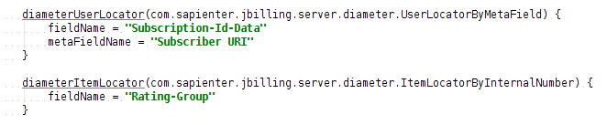
Diameter
Components
DiameterBL.java
resources..groovy

Slide 12
Diameter
Usage
API:
public DiameterResultWS createSession(String sessionId, Date timestamp, BigDecimal units, String data) throws SessionInternalError {…}
public DiameterResultWS updateSession(String sessionId, Date timestamp, BigDecimal usedUnits, BigDecimal reqUnits, String data) throws SessionInternalError {…}
public DiameterResultWS extendSession(String sessionId, Date timestamp, BigDecimal usedUnits, BigDecimal reqUnits) throws SessionInternalError {…}
public DiameterResultWS endSession(String sessionId, Date timestamp, BigDecimal usedUnits, int causeCode) throws SessionInternalError {…}
Diameter Library:
SessionHelper.java
Defined in resources.groovy

Slide 14
!Thank you!

